Slide 1
AQA
GCSE
Design and Technology 8552
Investigation, primary and secondary data
Unit 6
Designing principles
1

Slide 2
Objectives
Understand how primary and secondary data can be collected to assist the understanding of client and user needs
Know how to write a design brief and produce a manufacturing specification
Understand how the environment, and social and economic challenges influence designing and making

Slide 3
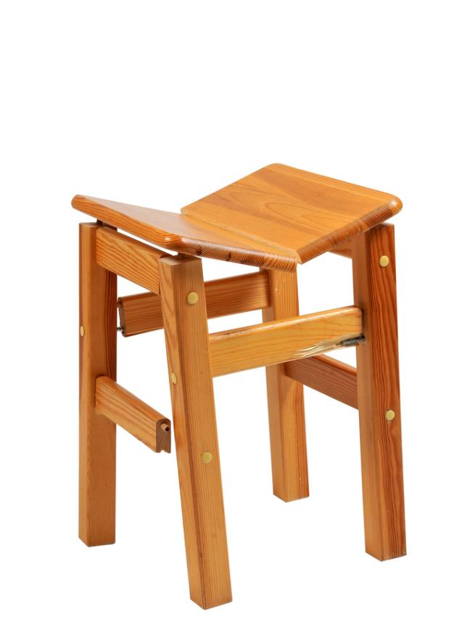
Early ideas
Before designing any product it is crucial to undertake research to help inform the designer
The research should be: relevant, useful, meaningful and efficient
What information do you think would be helpful for a designer making a chair for a café?

Slide 4
Investigation and research
Sources of data and information fall into two categories – Primary and Secondary
Primary data is new data, gathered by the researcher
Sources include: interviews, focus groups, questionnaires and case studies
Secondary data is gathered as part of research or reporting on primary data
Sources include articles, books and magazines
What other ways are there of gathering both primary and secondary data?

Slide 5
What do you need to know?
The design proposal will raise a series of questions
Where might you gather the following information?
What are the client’s requirements?
Who will use the product?
Suitable materials for manufacture and the cost?
What size should it be?
Primary sources of data can also include: physical material testing, measurements and user observations

Slide 6
Market research
Research helps designers analyse and identify the market need for a product, the competition and the customer base
Information can be gathered using interviews and questionnaires
Non-specific, open-ended questions can help to gather general information
Detailed questions help collect answers to very specific points
What variety of methods could you use to collect this type of market research?
How would you prepare to gather this data effectively?

Slide 7
Product analysis
As part of your research, it’s essential to know what else is on the market and how it’s made
Consider the functionality of the product
Observe the aesthetics and customer appeal
Note the use of materials and the finish
Analyse both the successful and weak areas of a design
Qualitative feedback from focus groups is informative
How does this analysis help a designer improve their design?

Slide 8
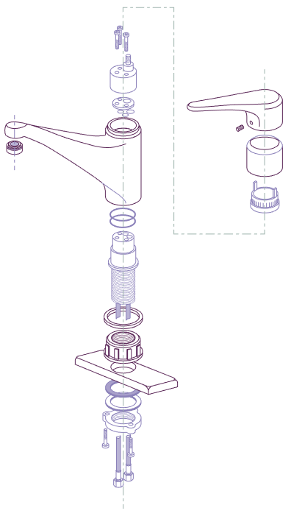
Functional performance
Product analysis can help your awareness of:
Production methods
Which materials have been used and types of finishes
How materials perform, both functionally and aesthetically
What areas should you consider when carrying out product analysis?

Slide 9
Product analysis results
Consider the following areas and their options:
Form – shape, size, weight, colour, texture
Materials – mild steel, glass, cotton, oak
Manufacturing processes – injection moulded, drape formed
Cost – production costs and retail price
Function – what does it do?
Standard components – nuts, bolts, switches, rivets, zips
Ergonomics – how easy it is to be used
Environmental factors – use of sustainable materials, recyclable

Slide 10
Response to a product
A focus group is made up of a diverse group of people who might trial an early version of a design
Qualitative research will gather their reaction, perception and attitude toward a product
Testing and questions will also give information on their experience of using or working with the product

Slide 11
Focus group approach
Focus groups can enable a business to engage directly with their customers
Listening to groups discussing their findings can help clarify feedback
Watching body language and a response to an item can also give a good insight to a customer’s reaction

Slide 12
Ergonomics and anthropometrics
Ergonomics
The science of how humans interact with objects
Design for efficiency and comfort in the working environment
Anthropometrics
Measurement of the physical properties of the human body
It derives from the Greek words ‘Anthropos’ (human), and ‘metron’ (measure)
Should this form primary or secondary research?

Slide 13
Ergonomic design
When designing a product, it should be both comfortable and functional
Designers will study the way people interact and work with an object
They will consider the physical and emotional connection to a product
Touch and feel as well as sound and smell are all relevant
Can you identify some well known items that have evolved and improved with the use of ergonomics?

Slide 14
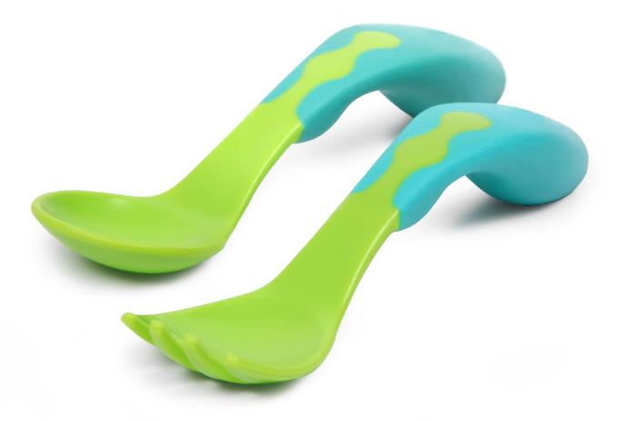
Day to day ergonomics
Many everyday items have been made more comfortable and effective to use
Do you think these are more expensive to make? Discuss

Slide 15
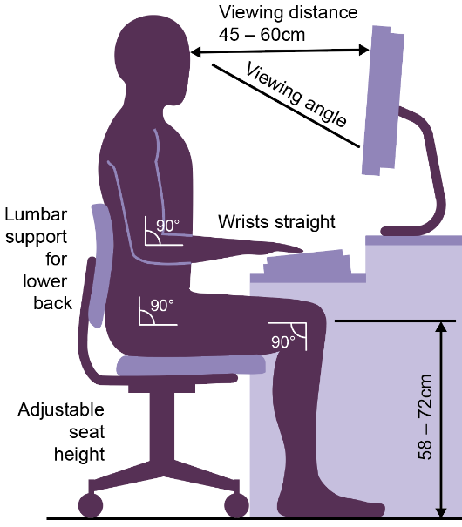
Anthropometrics
Designers gather the measurements of the average individual human, looking at:
Height, weight and length
Angle of reach
Viewing distance and viewing angles
A typical example of anthropometrics looks at the correct way to sit at a desk to maintain a comfortable position
Name two other items that have been improved by the use of anthropometrics

Slide 16
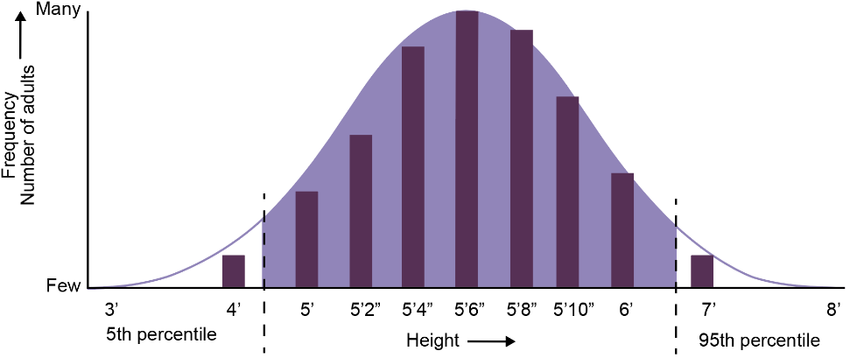
Graphs and charts
Most anthropometric data is presented as a bell graph
It’s not easy to make products fit 100% of the target audience
Often the top and bottom 5% of people will be excluded
The 50th percentile is the average person or mean value

Slide 17
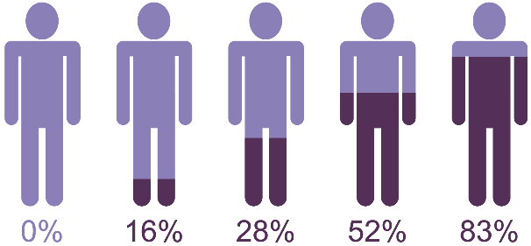
Present your data clearly
Once you have gathered your information, it needs to be presented in a relevant and meaningful way
Summarise the findings of your market research
Present a conclusion if this is evident from your data
Clear presentations with the addition of photographs, audio or video recordings provide additional input
Graphs will help summarise your statistics

Slide 18
Worksheet
Complete Task 1 in the worksheet

Slide 19
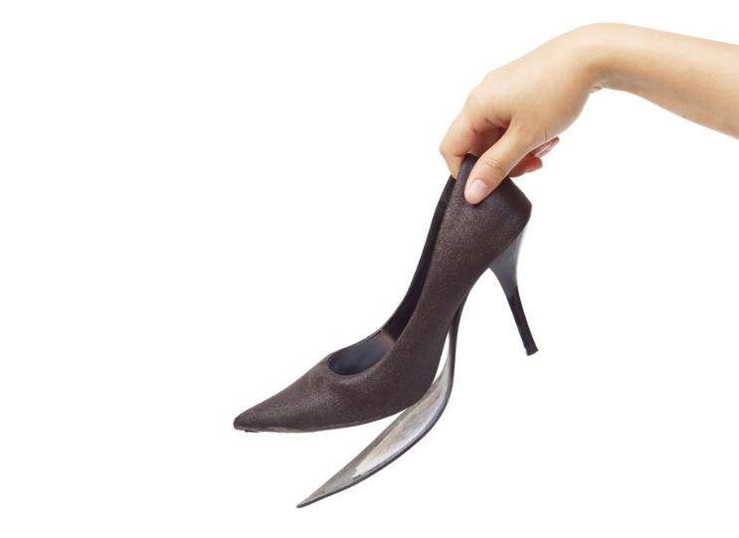
Design brief
This is the conclusion of all your research and data
A statement of intent will summarise your design plan:
What are you going to design?
Who is the target audience?
Where are they going to use the product?
What is the budget?
When does it need to be completed?
What size does it need to be?
Some of these are known as immovable constraints
Which do you think are immovable and why?

Slide 20
Write your own brief
A brief is vital to any design project. It should be clear and precise and potentially inspiring
It should clearly identify the clients wants and needs
Client: Café owner
Style: Contemporary
Location: City centre
This new café would like stylish, but hard wearing seating for its new space. It also has a comfy area for relaxed seating.
Please supply a cost per seat and indicate any savings for ordering in large quantities.
Delivery should be in three months time, ready for opening.

Slide 21
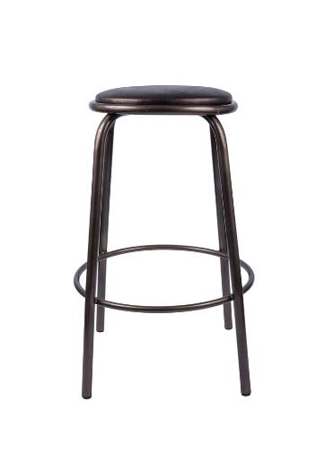
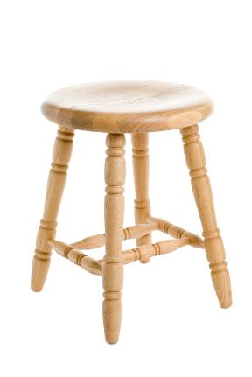
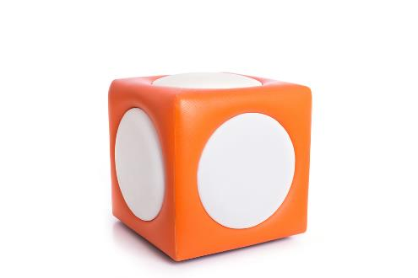
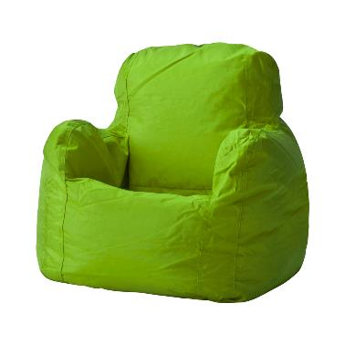
Worksheet slide
Complete Task 2 of the worksheet

Slide 22
Design specification
A design specification is used to describe all of the client and technical requirements gathered throughout the research process
It is a series of statements that outline:
The function and type of materials to be used in the product
The client requirements including anthropometric data
Before manufacture, the design specification is used to help create the final designs for the product
The final designs are then used to develop a detailed manufacturing specification

Slide 23
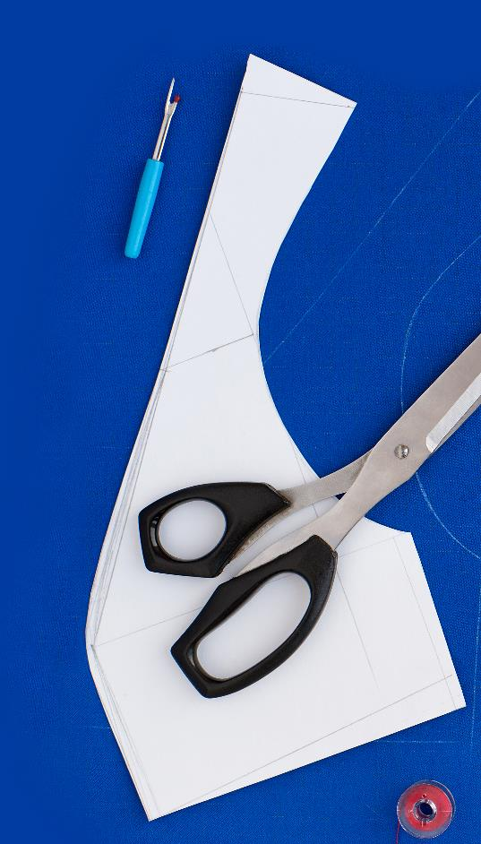
Manufacturing specification
A manufacturing specification is used to enable third party manufacture
It can include drawings, CAD or 3D models
It should be detailed and accurate, including dimensions, material choice, and a component list
It will be used as a basis for testing and evaluation
How can it be used to measure the success of a final product?
How could a product fail if this step in the testing process is missed?

Slide 24
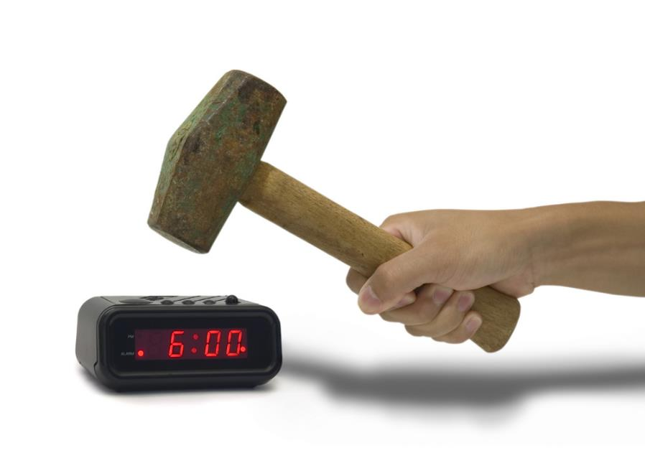
Test the design
The final product will need rigorous testing
Strength and stress loadings may need testing
Is it safe?
Does it function at the appropriate temperature?
Does it work?
How would you clearly record these findings?

Slide 25
Modify your design
Following on from the testing, the design brief may need modifications
Unforeseen changes may affect timescale, cost and material selection
These may be minor and have low impact on the design

Slide 26
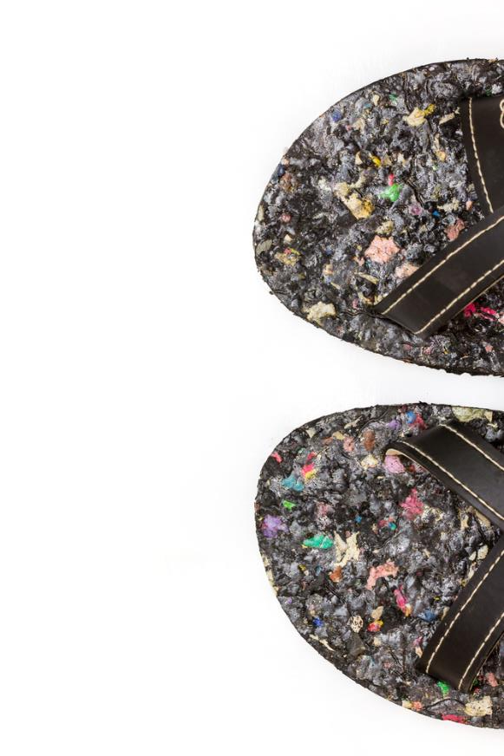
Environmental challenges
Responsible designers are sourcing alternative ways of manufacturing products
To help reduce the effect human activity is having on the environment designers consider:
New and innovative methods of using waste materials and recycled material
Reducing the use of scarce or limited resources
Lowering energy consumption
New, environmental friendly materials such as Bionic Yarn help change the stigma associated with recycled clothing

Slide 27
Social and economic solutions
Sustainable living aims to reduce our use of Earth’s natural resources. In manufacturing:
Disposal methods of waste materials have been refined
Opportunities are being created in developing countries to enable producers and growers to receive better trading conditions and promote sustainable farming
How can manufacturers reduce the quantities of materials being used?

Slide 28
Plenary
What role does research play in getting a design specification ‘right’ first time?
How might a design brief or manufacturing specification affect the latter stages of development?
What could cause a change to the original design specification?
What affect do changes to a design have on time and cost?

