Slide 1
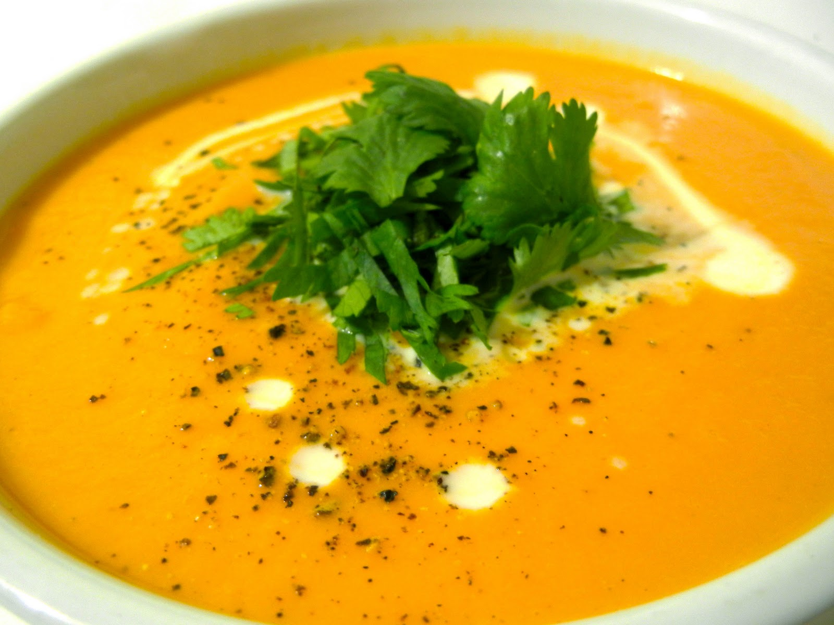
Carrot and coriander soup
Ingredients | Equipment | Learning outcomes | Skills used
500g carrots 1 onion 1 clove garlic 25g butter 25g plain flour 500 mls water Chicken or vegetable stock cube 2 tsps ground coriander 150 ml natural yogurt Salt and pepper Coriander leaves to garnish | chopping board sharp knife Vegetable peeler grater Medium saucepan mixing spoon Blender Measuring jug | Learn the importance of adapting recipes to meet a range of special dietary needs: vegetarian and vegans lactose intolerance food safety and hygiene when cooking. | Preparing a range of vegetables, using a grater, using the hob, controlling temperature, simmer the soup, ensuring that it does not boil over To demonstrate and apply the principles of
Method
Finely chop the onion and garlic
Peel and grate the carrots
Heat the butter in the saucepan and add the garlic and onion. Cook slowly without browning for 7 – 10 minutes
Stir in the flour to coat the vegetables
Add water
Add the carrots , ground coriander and crumble in the stock cube
Simmer very gently for approx 30 minutes until the vegetables are soft
Add salt and pepper
Puree in a blender or leave chunky
Stir in the yogurt and add a coriander leaf to garnish.
Top tips
You could use alternative vegetables e.g. Leeks or sweet potato. Bacon could be added too.

Slide 2
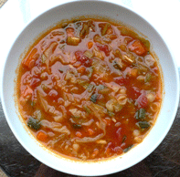
Spicy tomato soup
Learning Objectives: By the end of this activity you should be able to: measure ingredients; prepare ingredients, use a hob, can opener and blender.
INGREDIENTS 1 Carrot 1 Small potato 1 onion 1 can of chopped tomatoes 1 tspn chilli powder/ flakes 1 stock cube 1 can cold water (400mls) 1 tbsp tomato puree EQUIPMENT Saucepan, plastic spoon, knife, chopping board, vegetable peeler, tin opener | Method 1. Wash hands. 2.Collect equipment.. 3.Peel and cut the potato into small cubes. 4.Peel and chop the carrots 5.Peel and chop the onion 6.Put all the vegetables in a saucepan 7.Pour in the chopped tomatoes and stir 8.Crumble stock cube into the pan and add tomato puree and chilli flakes . 9.Fill the empty can with water and add to pan. 10.Stir everything together, bring to the boil and simmer for 20 minutes. 11.Serve with crusty bread
Top tips
You could use alternative vegetables e.g. Leeks or sweet potato. Bacon could be added too.
You could blend it to make it a smoother consistency.

Slide 3
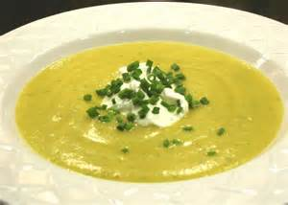
LEEK AND POTATO SOUP
Ingredients | Equipment | Learning outcomes | Skills used
2 medium leeks, cleaned small onion 300g potato e.g. Rooster 1tbsp oil or 15g butter 300 mls water Chicken or vegetable stock cube Salt and pepper Chives to garnish | chopping board sharp knife Medium saucepan White mixing spoon Blender Vegetable peeler Measuring jug | Learn the importance of adapting recipes to meet a range of special dietary needs: vegetarian and vegans lactose intolerance | Preparing a range of vegetables, using the hob, controlling temperature, simmer the soup, ensuring that it does not boil over To demonstrate and apply the principles of food safety and hygiene when cooking.
Method
Finely chop the white part of the cleaned leeks
Peel and cut the potatoes into slices
Remove skin from onion and chop finely
Heat 1 tbsp oil or butter in the saucepan and add the leeks and onion. Cook slowly without browning for 7 – 10 minutes
Add the potatoes with the stock cube (crumbled) and seasoning
Add water
Bring to the boil, lower the heat and cover the pan with a lid
Simmer very gently for approx 20 minutes until the vegetables are soft
Puree in a blender or leave chunky
Transfer to a soup bowl and add a garnish to decorate e.g. chopped chives

Slide 4
LEEK AND POTATO SOUP
Ingredients | Equipment | Method
2 medium leeks, 1 small onion 250g potatoes 300 mls chicken stock Salt and pepper Chives to garnish | Brown chopping board Brown sharp knife Medium saucepan White mixing spoon Blender Vegetable peeler Measuring jug | Finely chop the white part of the cleaned leeks Peel and cut the potatoes into slices Remove skin from onion and chop finely Melt the butter in the saucepan add the leeks and onion without browning for 7 – 10 minutes Add the potatoes with the stock and seasoning Bring to the boil, lower the heat and cover the pan Simmer very gently for approx 20 minutes until the vegetables are soft Puree in a blender or leave chunky Transfer to a soup bowl and add a garnish to decorate e.g. chopped chives

Slide 5
Minestrone soup
Ingredients | Equipment
1 Rasher of bacon 1 Onion 1 Carrot 1 Small potato 1 Celery stick 1 Leek 1 can of chopped tomatoes 1 tspn mixed herbs 1 Chicken OXO 1 tbsp pasta | Saucepan, plastic spoon, knife, chopping board, vegetable peeler, tin opener
1. Wash hands.
2.Collect equipment.
3.Prepare all vegetables.
4.Wash leek carefully under running tap.
5.Fry bacon for 5 minutes in a saucepan, then add onion and leek for 5 minutes.
6.Add the rest of the vegetables and fry for another 5 minutes.
7.Add mixed herbs and can of tomatoes.
8.Crumble oxo cube into the pan .
9.Fill the empty can with water and add to pan.
10.Leave to simmer for half an hour.
11.Add pasta.
12.cook for a further 10-15 minutes.

