Slide 1
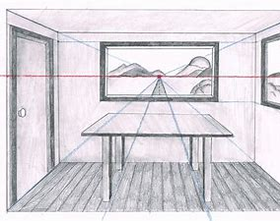
One Point Perspective
Room Drawings

Slide 2
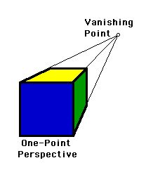
In school we have recently looked at 1 point perspective. You will have learned the definition for the following terms: - horizon line -vanishing point - orthogonal lines
Horizon line
Orthogonal lines

Slide 3
….. and put your understanding into practice in order to create various shapes using 1 point perspective

Slide 4
…… we then moved on to create a one-point perspective version of our names …….

Slide 5
Using one point perspective to draw a room.
Watch the following YouTube clip (https://www.youtube.com/watch?v=7ZYBWA-ifEs) to help you to understand how to use one point perspective to draw a room.

Slide 6
Remember the 1 Point perspective rule:
Every line that is drawn must do one of the following:
Be VERTICAL
Be HORIZONTAL
Or extend to or from your vanishing point

Slide 8
You may wish to add shade, colour and details

