Slide 1
AQA
GCSE
Design and Technology 8552
Commercial manufacturing, surface treatments and finishes Unit 5E Textiles
3

Slide 2
Objectives
Know and understand how textile based materials are selected and processed for commercial products
Understand why aids are used to judge quality and accuracy before and during processing
Understand how surface treatments and finishes affect the functional and aesthetic properties of textile products

Slide 3
Commercial textiles
Textiles today can stop a bullet, fight fire, hold back water, make you faster… and even less smelly
Highly automated, computer controlled production has increased productivity
What innovations in textile technology and manufacturing techniques have led to high performance fabrics?

Slide 4
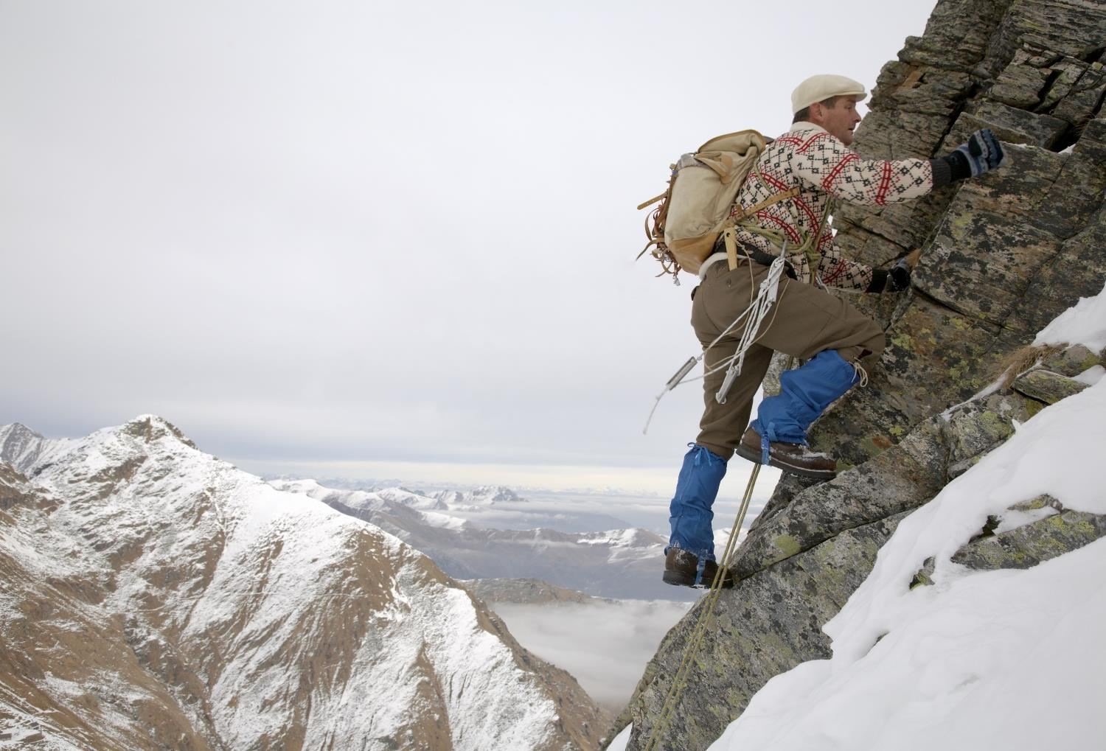
Material selection
What factors might a designer consider when selecting a material for a sports garment?
What properties might make a material suitable or unsuitable?

Slide 5
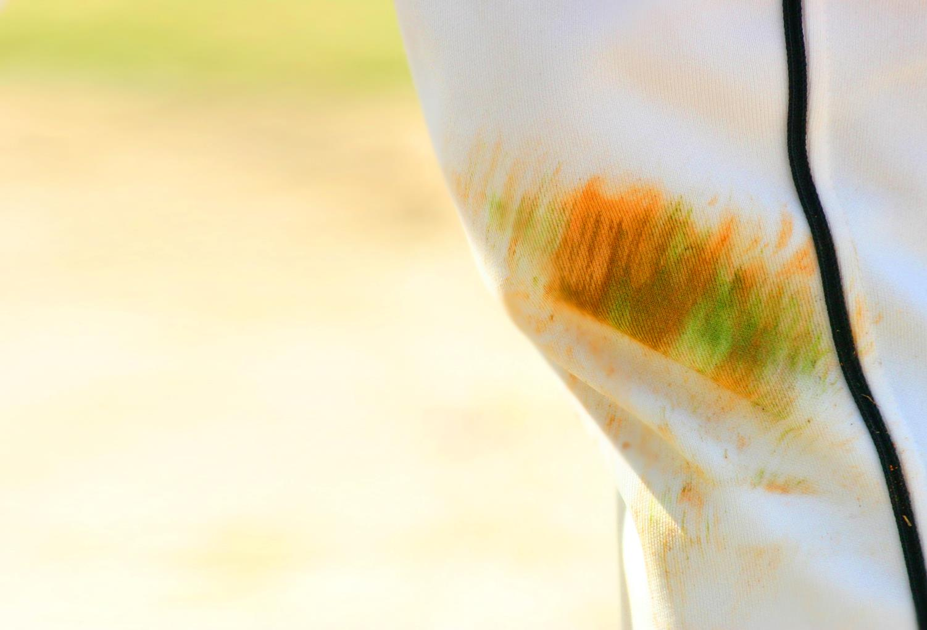
Surface treatments and finishes
Surface treatments can be added to a fabric or product to enhance performance or aesthetics:
Stain protection
Crease resistance
Heat transfer printing
Flame retardants
Waterproofing
Distressing (chemical and physical)
Brushing

Slide 6
Worksheet Task 1
Match the definitions to the correct finish or treatment (see example)
Specify a practical application for each treatment and explain your answer
Curtains
Emergency service uniforms
Football kit
Bedding
School uniform
Carpets

Slide 7
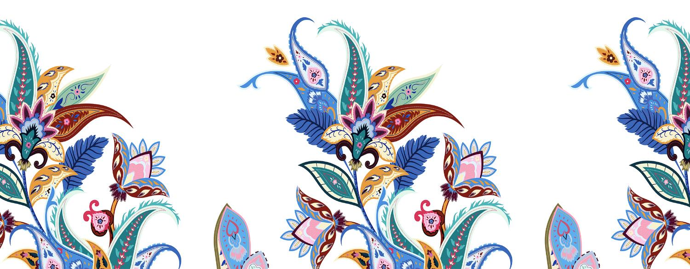
Commercial dyeing and printing
Dyeing and printing are used to add a colour, pattern or motif to fabrics
Dyeing affects the entire garment or fabric whereas printing generally only affects some parts

Slide 8
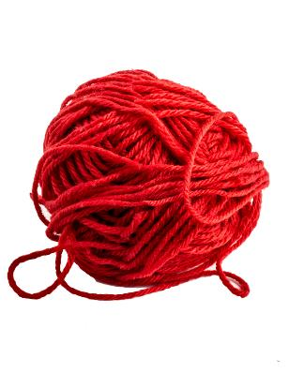
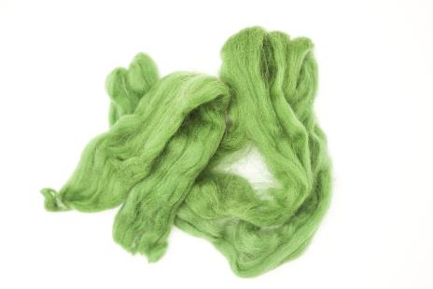
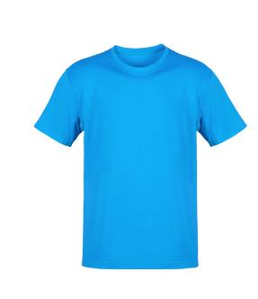
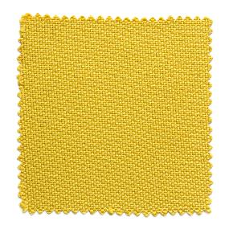
Commercial dyeing
Dyeing can happen at any stage of production
For some products it will be more cost effective, efficient and/or viable to dye the fibres, whereas other products will be made into garments and dyed later
Stock dyeing
Yarn dyeing
Fabric dyeing
Garment dyeing
Natural or synthetic fibres
Yarns
Fabric
Garment

Slide 9
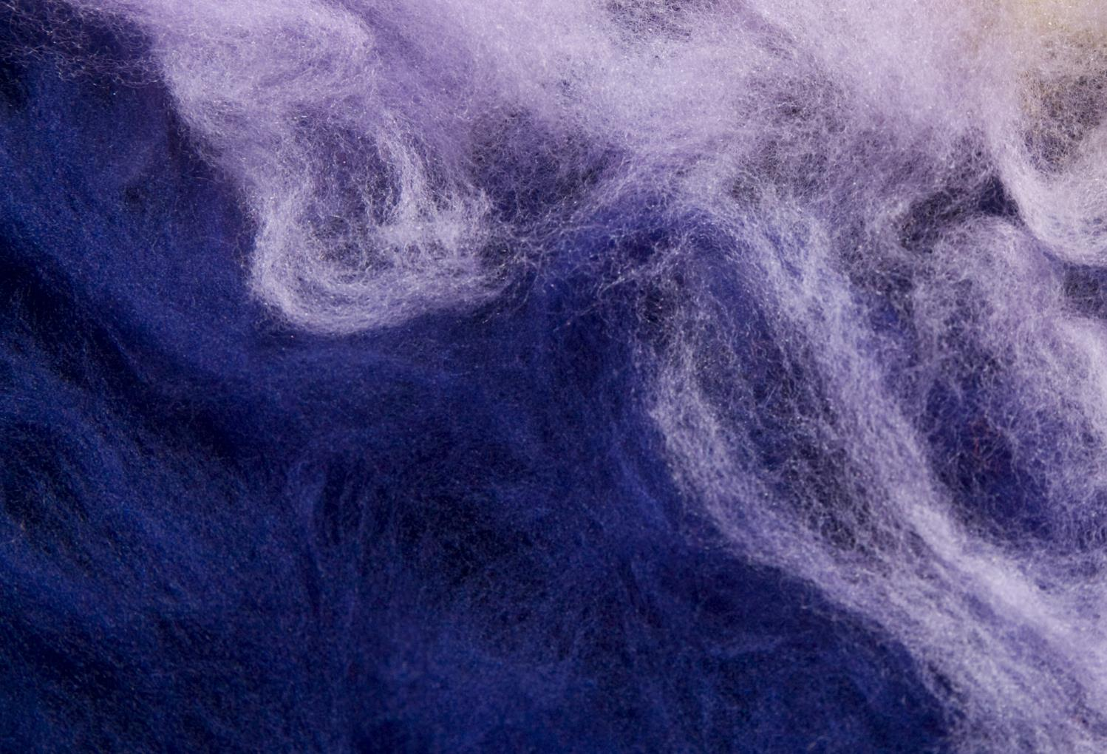
Stock dyeing
Stock dyeing is the dyeing of fibres
Natural fibres take colour very well and are dyed in large vats before being spun into yarn
Synthetic fibres are coloured during the liquid polymer stage before being extruded which gives them excellent colour fastness

Slide 10
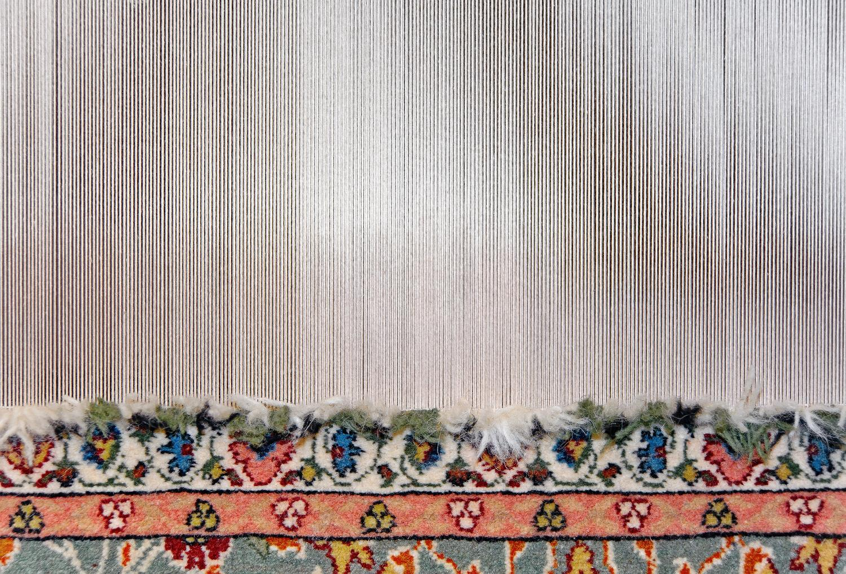
Yarn dyeing
Yarn dyeing involves dyeing spools or hanks of yarn before they have been woven or knitted into fabrics
Different coloured yarns can then be used to create different patterns in the weaving process
How is this evident in denim?

Slide 11
Dyeing fabrics
Dyeing fabric can be more economical for manufacturers as undyed fabric can be kept in stock and dyed at any time to suit changing trends
Dyeing at this stage is more common than stock, yarn or garment dyeing

Slide 12
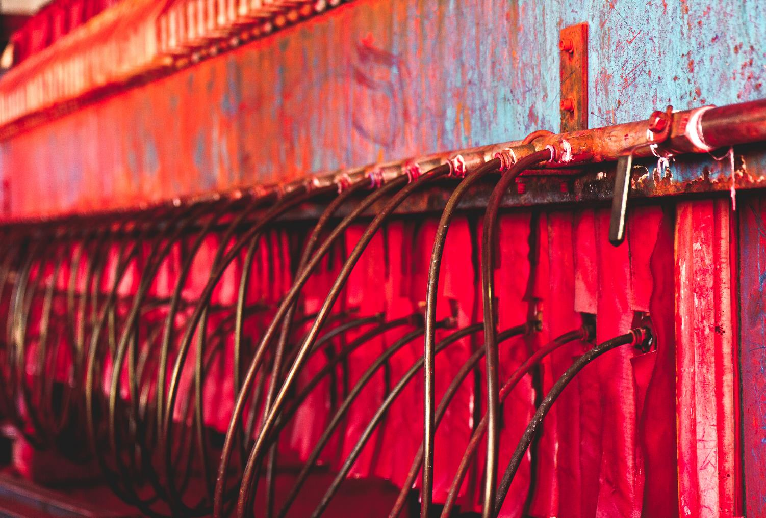
Commercial fabric dyeing
Fabric can be dyed in batches or in a continuous flow
Batch dyeing involves submerging fabric in a vat of dye
Continuous dyeing uses more sophisticated machinery to feed rolls of fabric over a series of dye pads and rollers in a constant flow

Slide 13
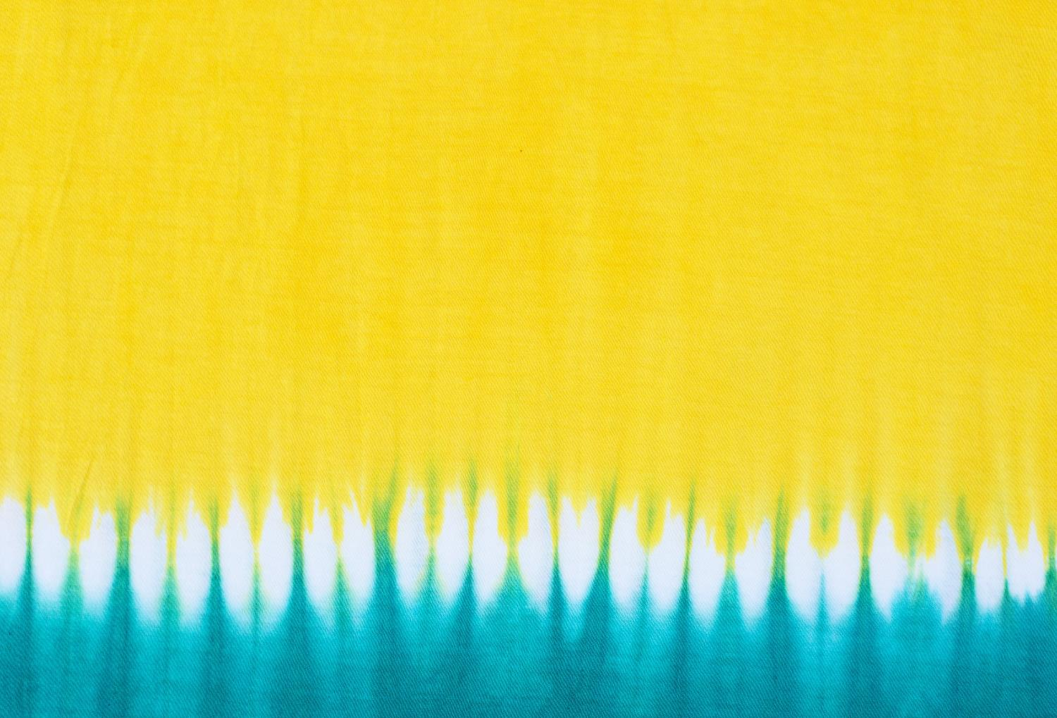
Garment dyeing
This process dyes manufactured garments rather than manufacturing them from pre-dyed fabrics
The dye may not penetrate fully into stitching or the fibres between seams, buttons, zippers etc.
Suitable for woven or knitted garments and commonly used for lingerie, socks and sweaters
This allows retailers of fashion products to meet consumer demands for the latest colour trends

Slide 14
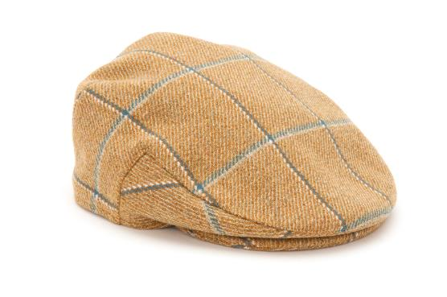
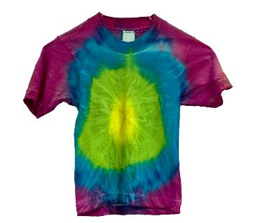
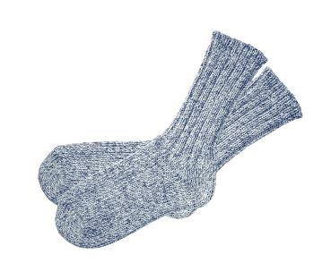
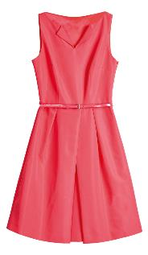
When were they dyed?
Identify when each item below was dyed in the manufacturing process:

Slide 15
When were they dyed?
Identify when each item below was dyed in the manufacturing process:
Dyed yarn
Dyed garment
Dyed fibres
Dyed fabric

Slide 16
Worksheet 3
Complete Task 2

Slide 17
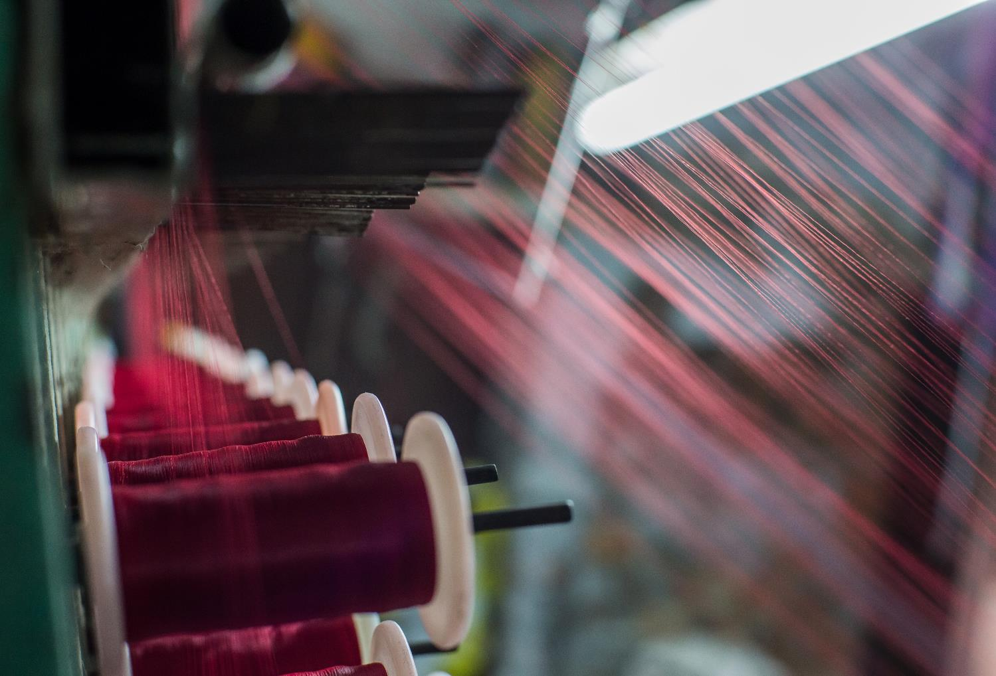
Commercial weaving
Industrial looms are often computer controlled
This enables CAD designs to be prototyped and manufactured and significantly increases output

Slide 18
Commercial printing
Most commercial printing in textiles works on one of three principles:
Screen printing on to fabric by forcing ink through a fine mesh or screen
Relief printing using engraved blocks or rollers to transfer ink on to fabric
Digitally printing directly on to fabric

Slide 19
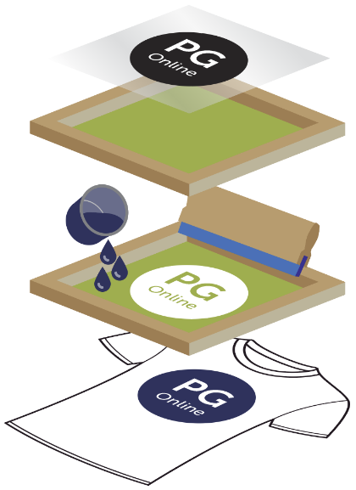
Screen printing
The screen is stretched over a frame and is treated with a light sensitive emulsion
A film or paper with the design is placed on the screen and exposed to bright light
The light “fixes” the emulsion in place, blocking the holes in the screen
Ink is then forced through the screen and on to the product with a squeegee
Screen printing for smaller batches can be done with a handheld screen

Slide 20
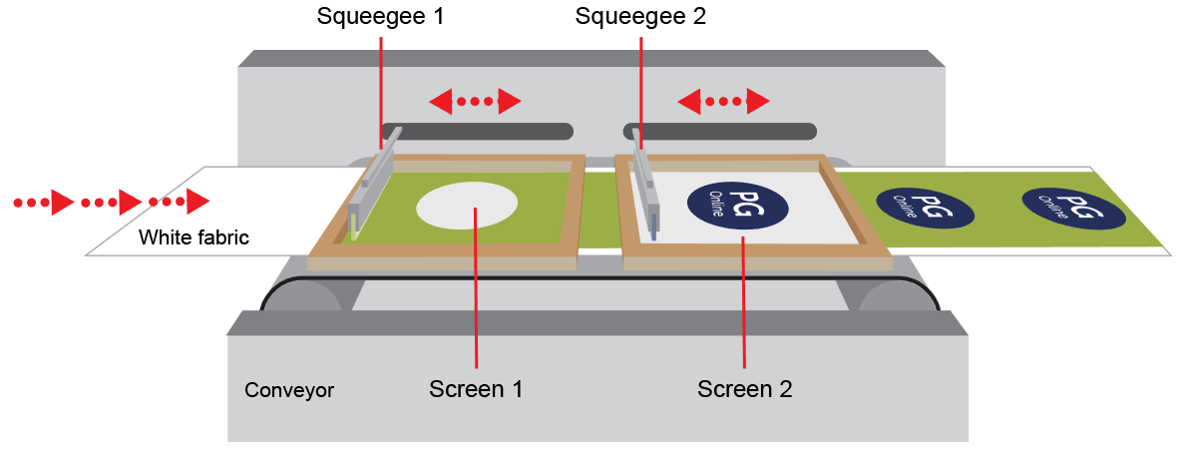
Commercial screen printing
Flatbed screen printing uses several screens, printing different colours on a conveyor belt
Each colour requires a different screen

Slide 21
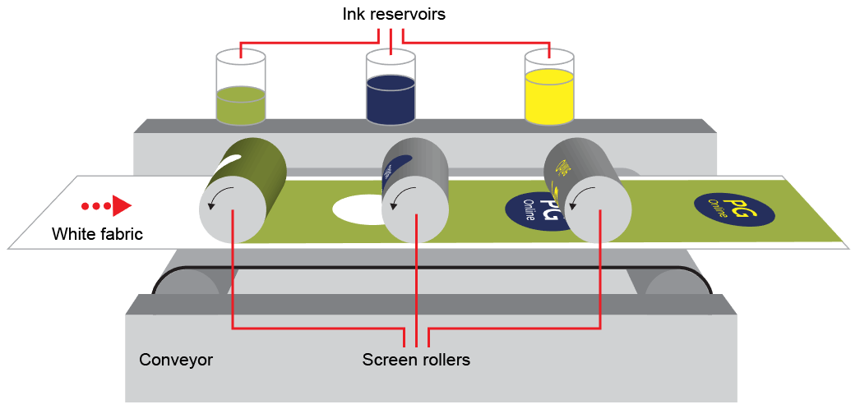
Rotary screen printing
Commercial screen printing can also be done on rollers – this is called rotary screen printing
The screens are wrapped into cylindrical rollers with an internal squeegee to force the ink through the mesh

Slide 22
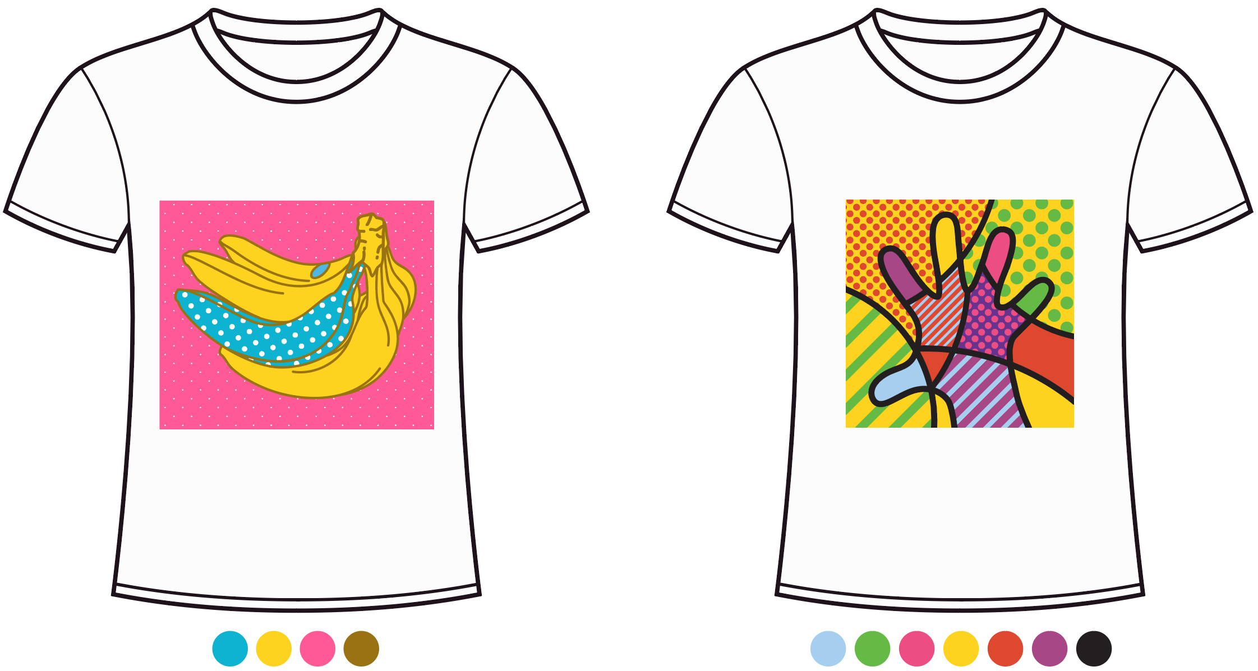
Worksheet Task 3
4 Colour Print
7 Colour Print

Slide 23
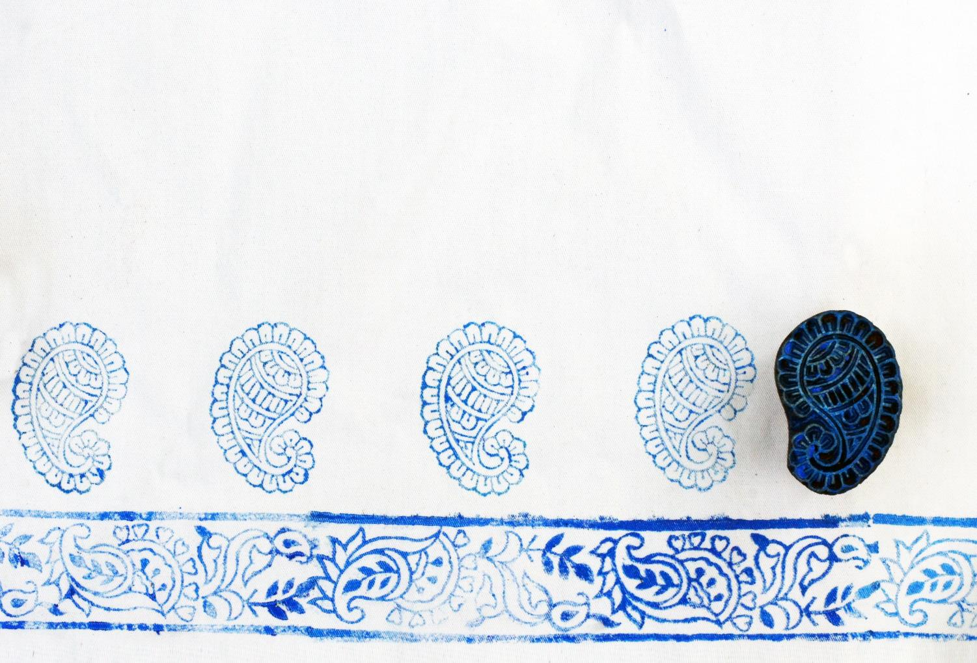
Relief printing
Block printing is a traditional form of relief printing which uses blocks made from wood, lino or metal
Print blocks have a raised surface which picks up the ink and transfers it from the ink tray to the fabric

Slide 24
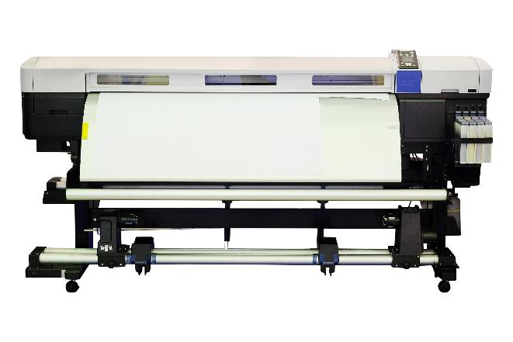
Digital printing
Digital fabric printing will print digital images on to fabric, much like we print on to paper
Different inks are selected for different fabric types and the quality and durability of inks can vary
Some prints have a waxy quality, like the prints on a t-shirt, whereas others have no effect on the texture of the fabric

Slide 25
Quality control
Quality control checks are undertaken at various stages during the manufacture of a product
Checks are made on:
Raw fabric and components
Dyed and printed fabrics
Prototypes
Products in a production run
What kind of faults might you expect to find?

Slide 26
Common defects
Common defects in fabric are spotted by visual inspection
Faults can include:
Stains
Twisted or pulled yarns
Rips
Frays
Tears
Print defects include misalignment and poor ink absorption

Slide 27
Dimensional accuracy
Repeating patterns should be precisely stitched together along seam lines
How could you best check that a design has been accurately represented?

Slide 28
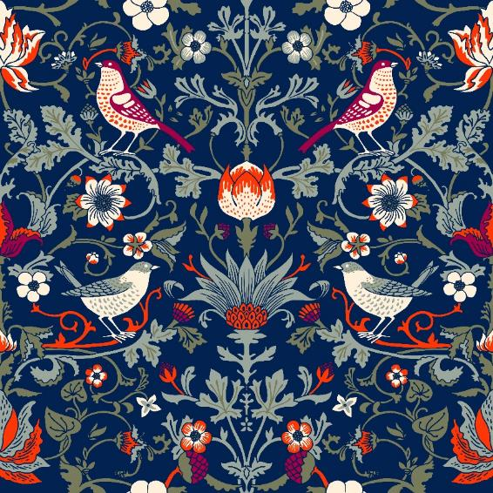
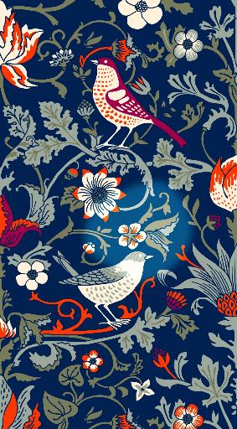
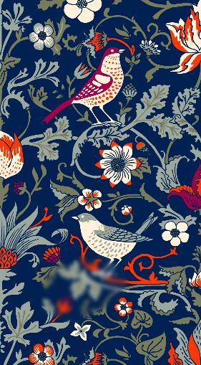
Worksheet Task 4
Spot the difference

Slide 29
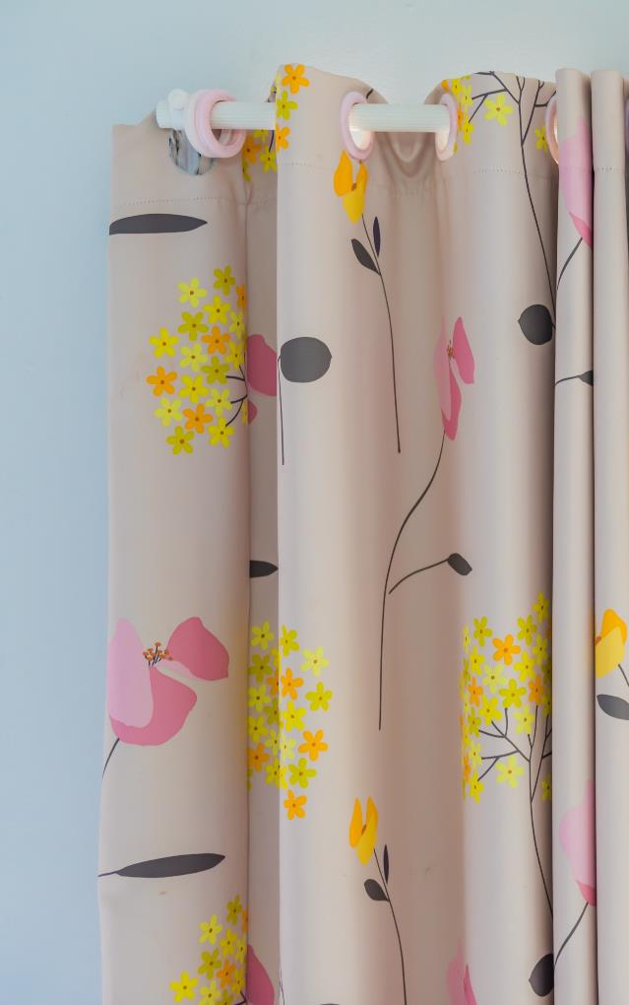
Worksheet Task 5
Study the curtain fabric and identify the following:
Dyeing methods
Method of printing
Quality control check for pattern
Surface treatment

Slide 30
Plenary
How are denim garments lay planned and cut?
What properties of denim make it so desirable?
What quality control measures could be taken to ensure products are of a high enough standard?
How do surface treatments and finishes affect the functional and aesthetic properties of denim?

