Slide 1
AQA
GCSE
Design and Technology 8552
Sources, origins and properties
Unit 5E
Textiles
1

Slide 2
Objectives
Understand the processes involved in obtaining raw material from animal, chemical and vegetable sources
Be aware of sustainability issues in textile production, in use and end of life

Slide 3
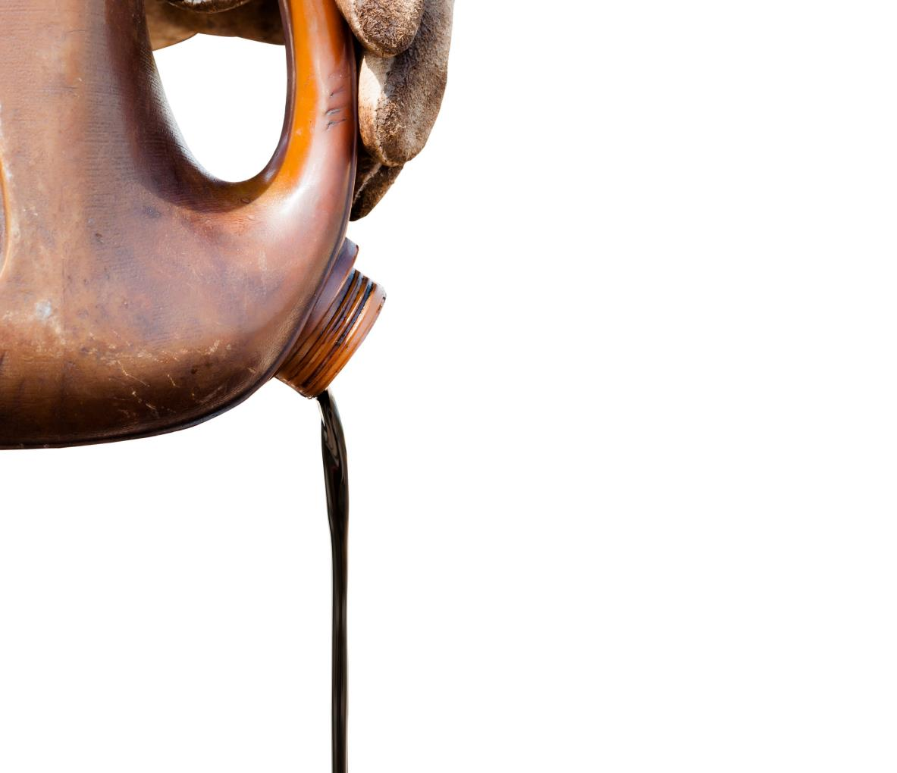
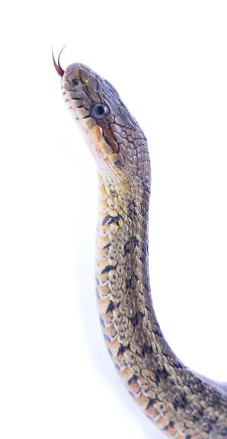
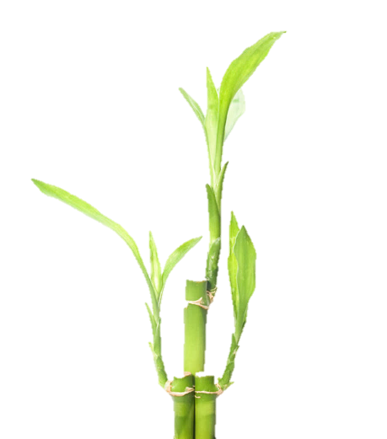
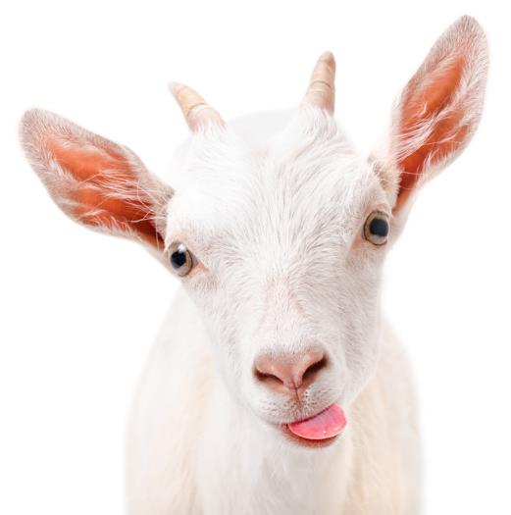
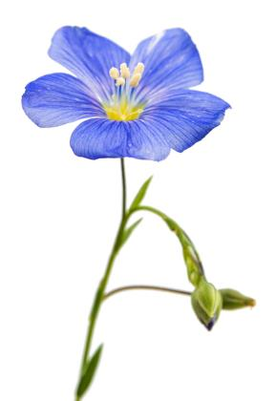
Starter
Identify and find the link between each of the images below:

Slide 4
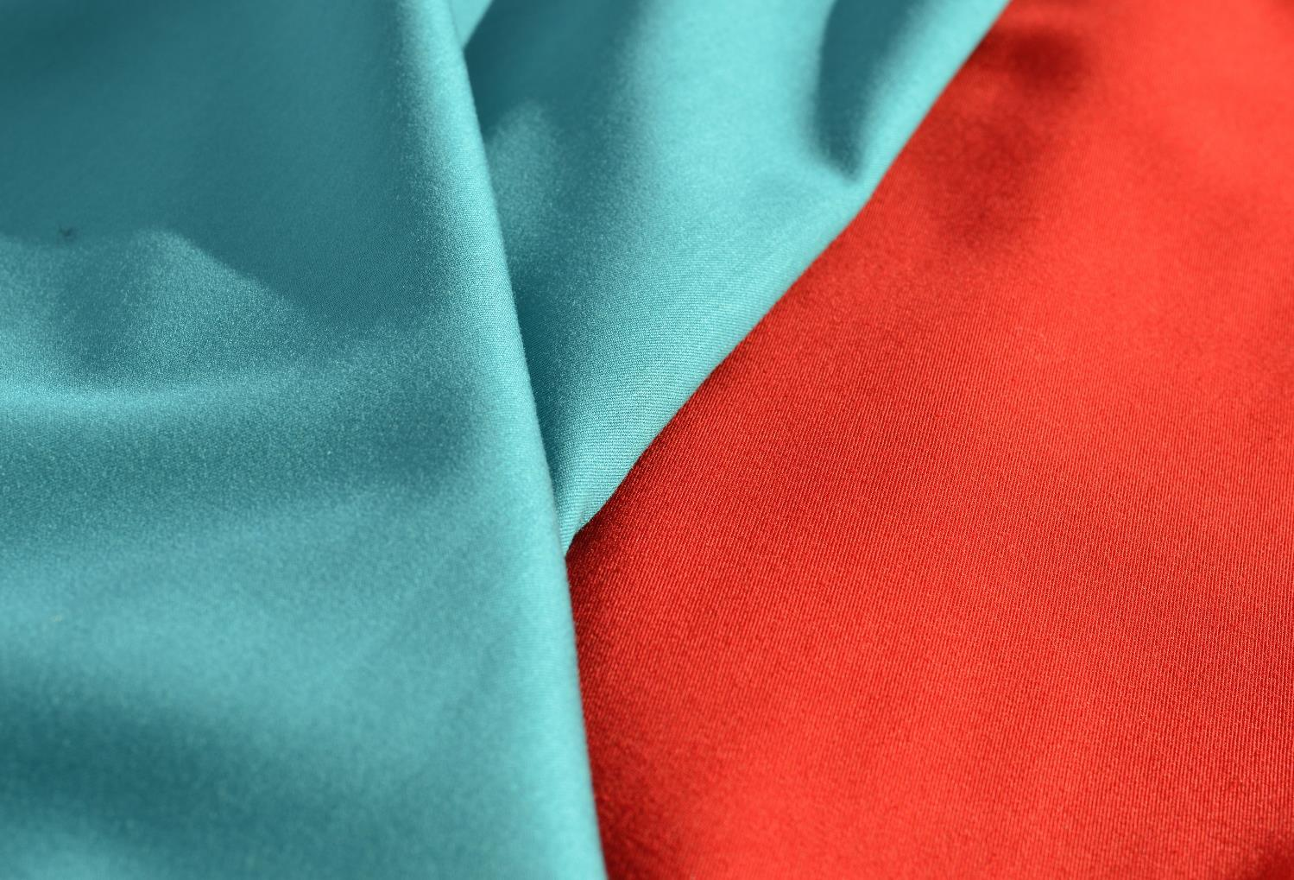
Raw materials for textiles
Raw materials for textiles can be categorised into:
Animal sources
Chemical sources and
Vegetable sources

Slide 5
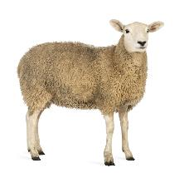
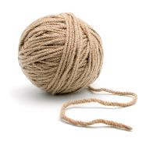
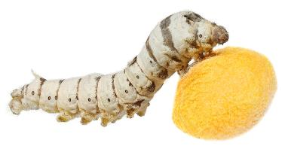
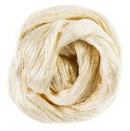
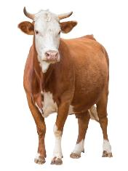
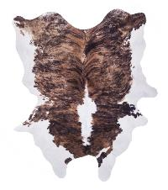
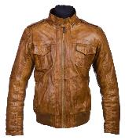
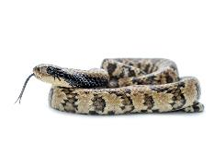
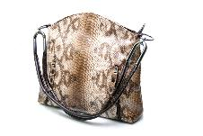
Animal sources
Animal fibres and skin (known as hides) can be processed into fabrics
Fibres (e.g. wool and silk) are spun to create yarn for fabrics
Hides or skins are treated to produce goods

Slide 6
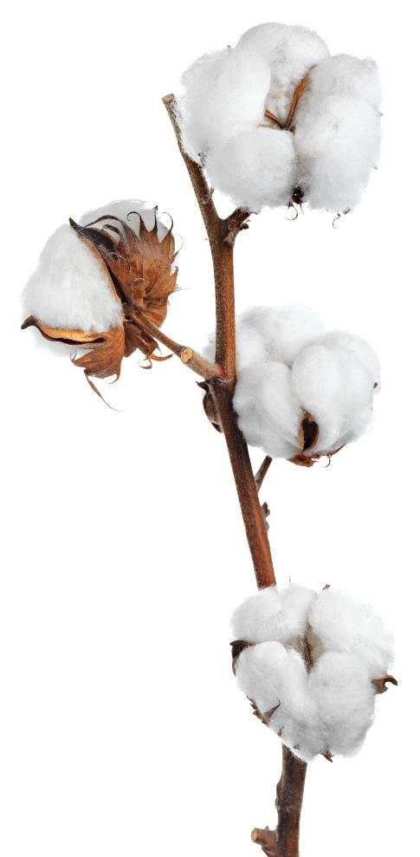
Vegetable sources
Plant or vegetable sources (e.g. cotton, jute, hemp and bamboo) are used in the production of many common fabrics
Other examples include flax which is made into linen and coir which is made from coconut fibres
Are these renewable?
Are they sustainable?

Slide 7
Chemical sources
Crude oil is used to produce chemicals which are processed into fibres to construct fabrics
Petroleum is commonly used to produce synthetic threads including nylon, polyester and acrylic
These are often combined with other fabrics to enhance their properties
How might their properties be enhanced?

Slide 8
Aramids
Aramid fibres, used in Kevlar® and Nomex®, are used to create some of the strongest, most heat resistant fabrics on the planet
They are used in:
Fireproof clothing including uniforms
Spacesuits
Tyres and work boots
Cut resistant gloves
Stab and bullet proof vests

Slide 9
Raw materials
Complete Worksheet 1 Task 1
Animal, Chemical or Vegetable?
Sort the raw material sources into the correct category
Match the fabric to the raw material

Slide 10
How are fabrics processed?
There are many different processes for converting raw materials from their sources
Weaving
Knitting
Carding
Bonding
Tanning

Slide 11
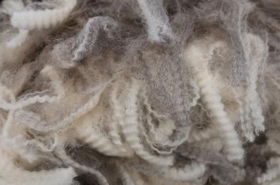
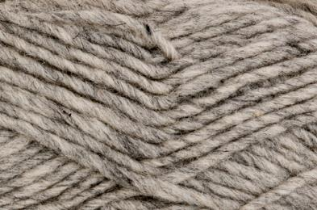
Processing yarns
To produce most fabrics, fibres will need to be processed into yarns
Yarns can then be woven or knitted into fabric
Fibres
Yarn
Fabric
Spinning
Weaving or knitting

Slide 12
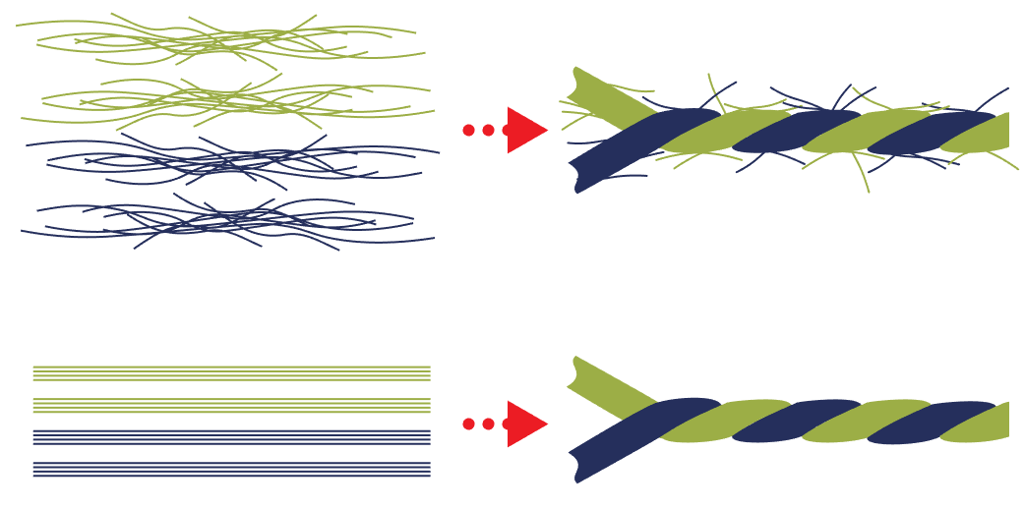
Staple fibres and filaments
Most natural fibres come in short hairy strands called staple fibres whereas all synthetic fibres are usually long and smooth – these are called filaments
Why are staple fibres often more absorbent and warmer?
Staple fibres
Staple fibre yarn
Filaments
Filament yarn

Slide 13
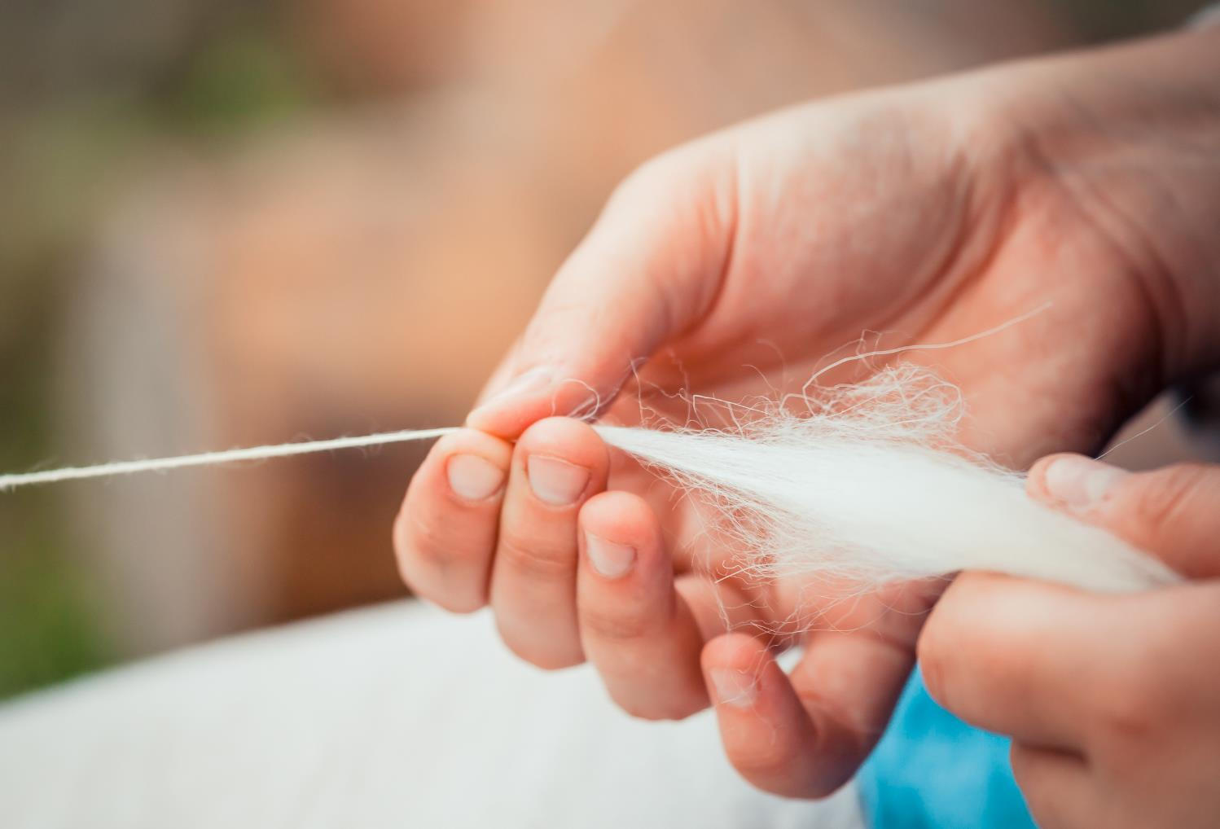
Spinning fibres into yarn
Staple fibres and filaments are spun into longer, stronger yarns which can then be woven together to create fabrics

Slide 14
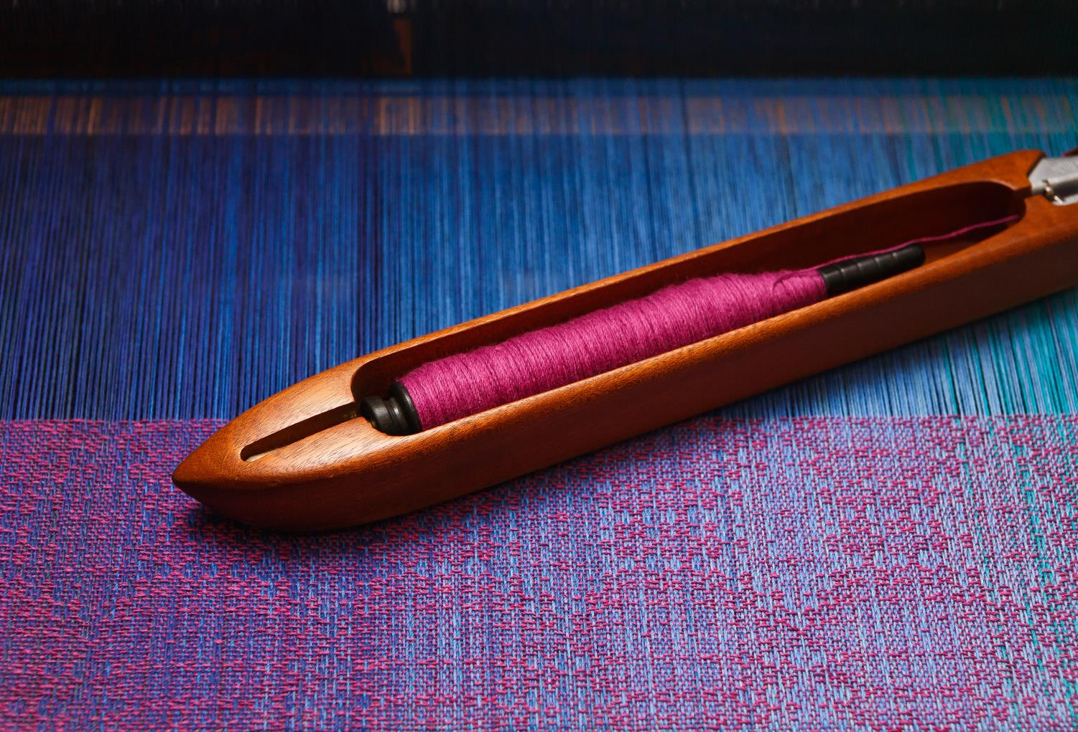
Weaving and knitting
Both weaving and knitting can be done by hand or by machine

Slide 15
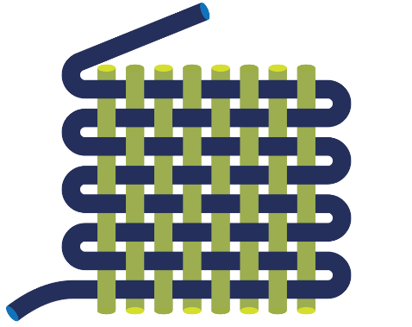
Warp and weft
Woven fabric is made of interlocking strands of yarn called the warp and the weft
A common type of weave is called plain weave
The warp runs the length of the fabric while the weft runs across the width
Bias
Weft threads
Selvedge
Warp threads

Slide 16
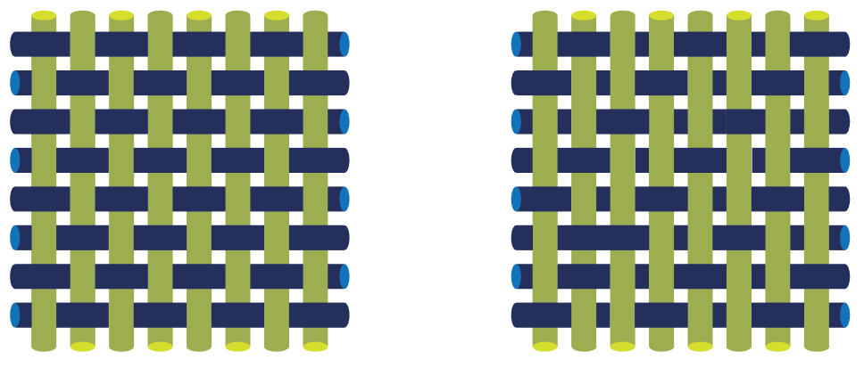
Twill weave
Twill weave uses a different pattern which creates different functional and aesthetic properties
Can you spot the difference?
Plain weave
Twill weave

Slide 17
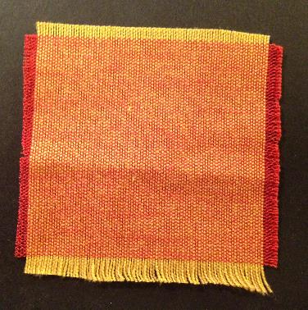
Worksheet experiment
Take a swatch of woven fabric
Is it plain weave, twill weave or another kind of weave?
Dissect the swatch into yarn and then into fibres
Use your findings to complete Tasks 2 and 3

Slide 18
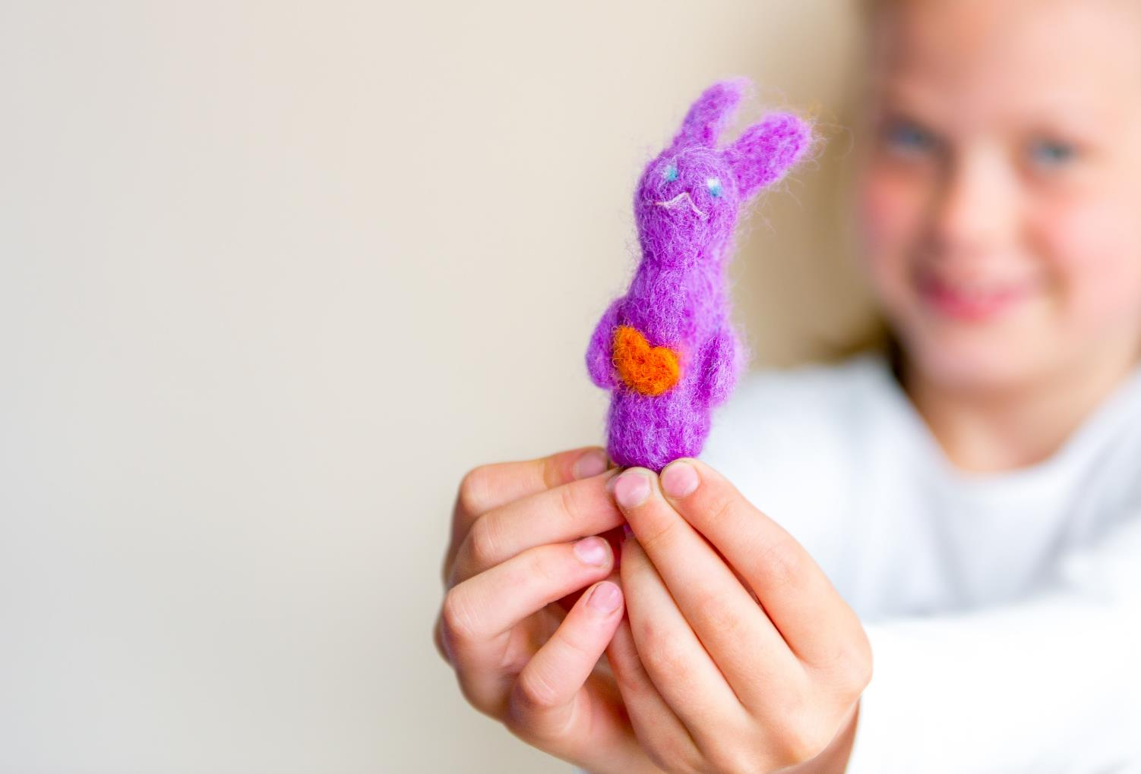
Making felt
Felting is a process where staple fibres are randomly interlocked and compressed to form a matted fabric or 3D product
Felting can be done by hand or by machine
What are common uses for felted fabrics?

Slide 19
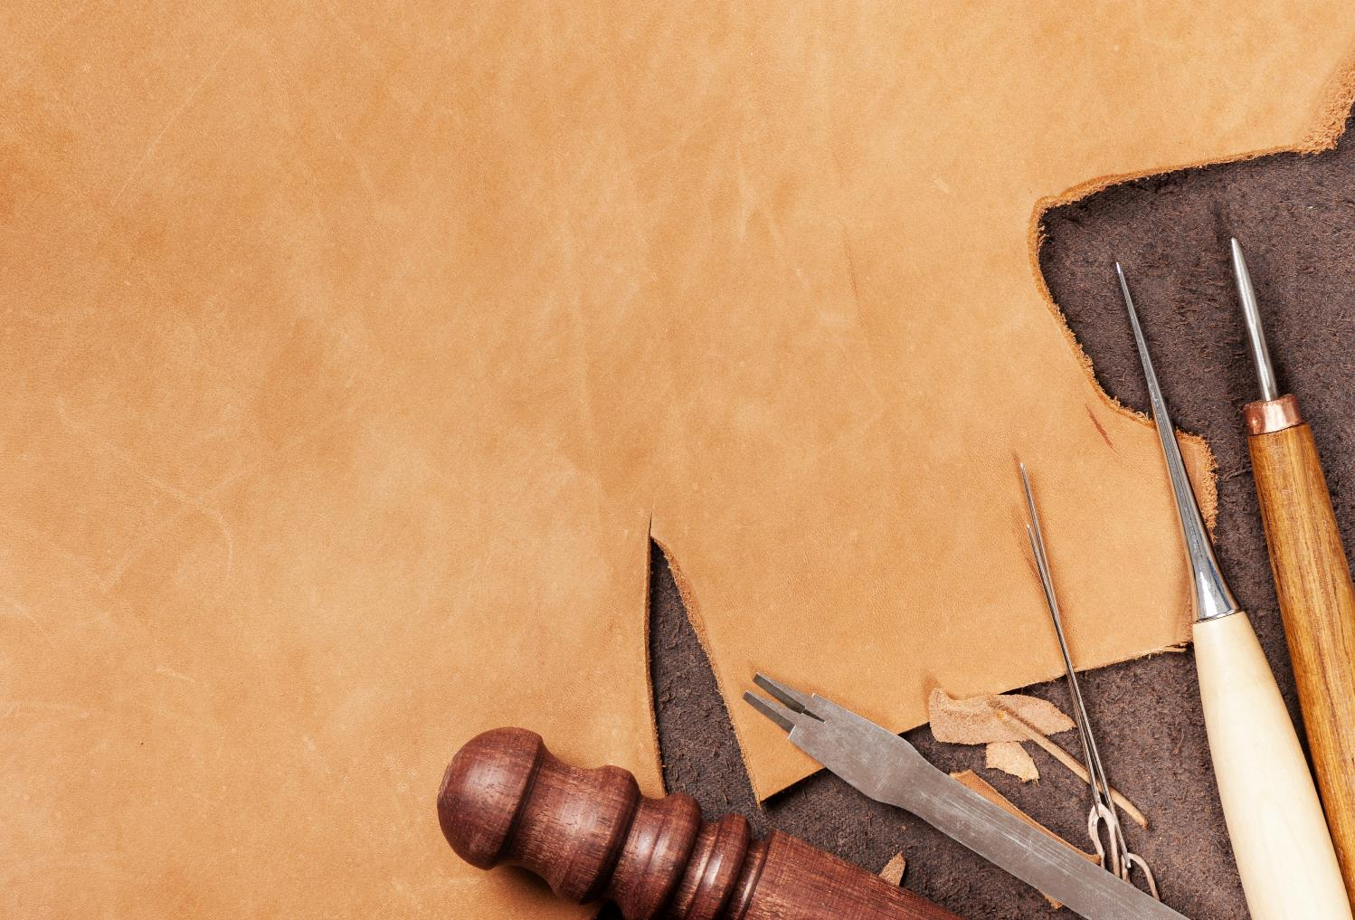
Tanning leather
Animal skins or pelts are preserved with a chemical process called tanning
Raw hides are cleaned, soaked in lime to remove hair and salted to help chemicals penetrate the pelt
Prepared hides are treated with acid and chromium to produce “wet-blue” leathers
These are then dried, softened and buffed to a workable finish

Slide 20
Bonded fabrics
These fabrics are created by fusing fibres together using heat, stitching, adhesives or chemicals
They are often used in textiles for interfacing and in disposable clothing and cleaning fabrics
What properties make bonded fibres suitable for cleaning cloths?

Slide 21
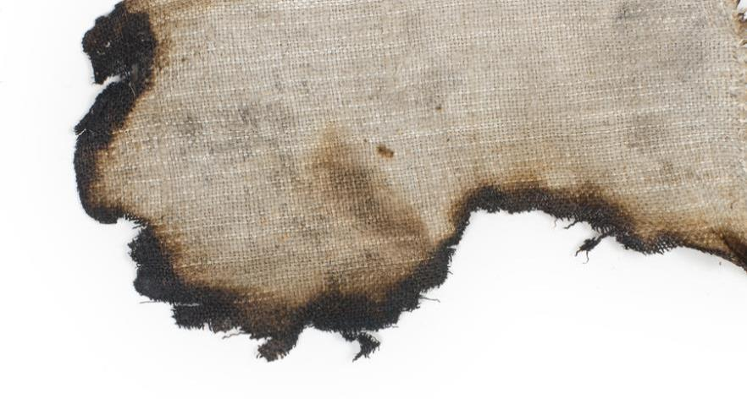
Flame retardants
All fabrics can be treated with flame retardants
By law (since 1988) certain soft furnishing and upholstered furniture must be treated with flame retardants to reduce the risk of fire or burns
Examples of use include sofas and curtains

Slide 22
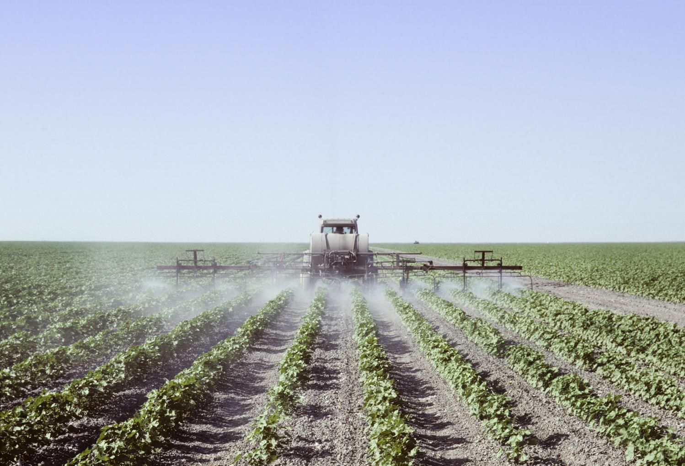
Environmental factors
What is the true cost of textile production to people and the planet?
How can the sustainability of textile production be increased?

Slide 23
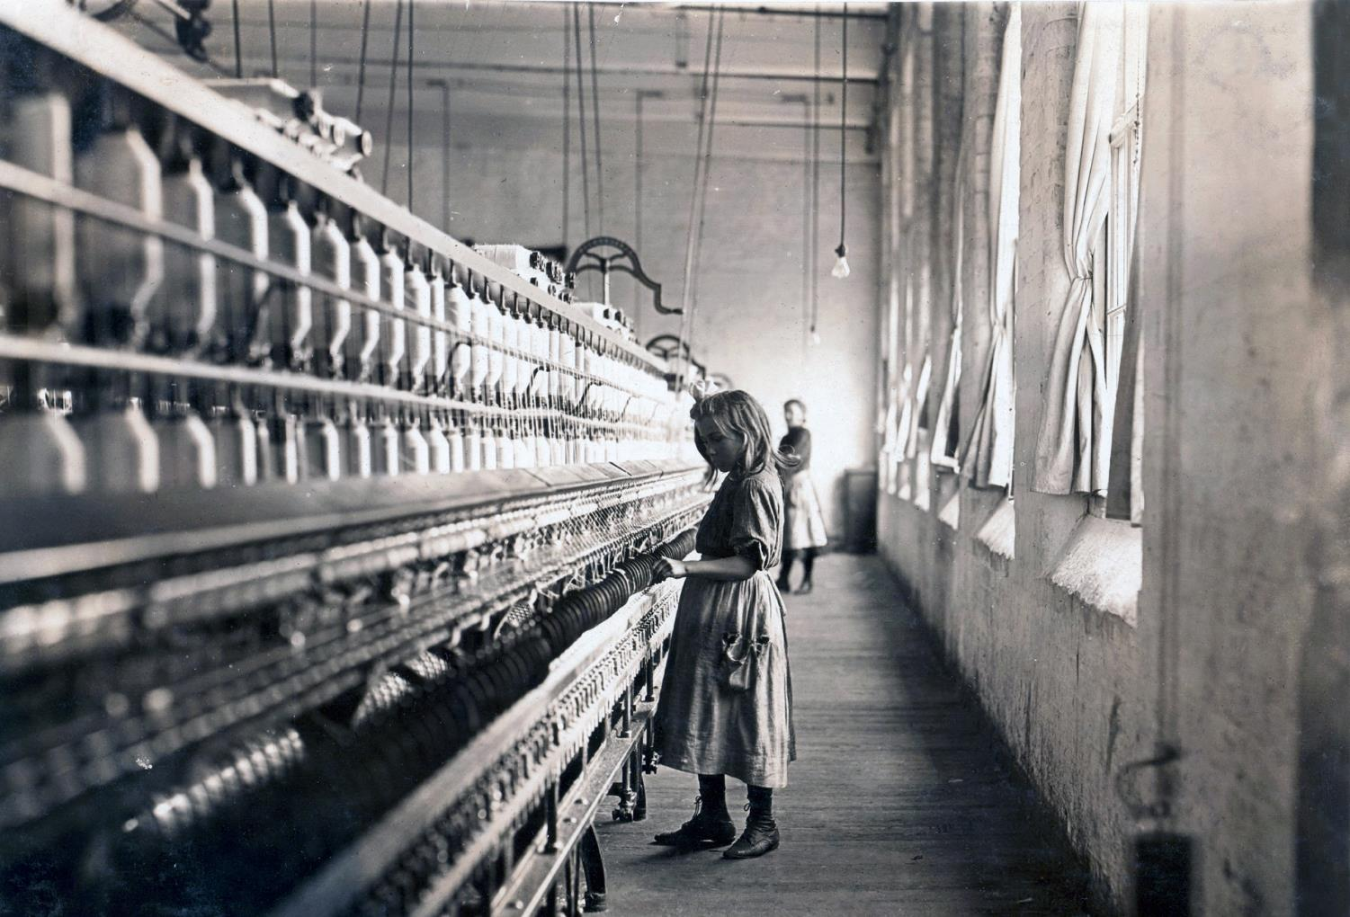
Ethical considerations
Land and resources in developing countries are used to create products for western markets
Would you buy a garment made using child labour?

Slide 24
Lifecycle analysis
A lifecycle analysis helps you to understand the environmental impact of a product
Sourcing raw materials
Manufacture
Distribution
Use
Recovery
Why is Use one of the most environmentally significant phases of a textile product’s life cycle?

Slide 25
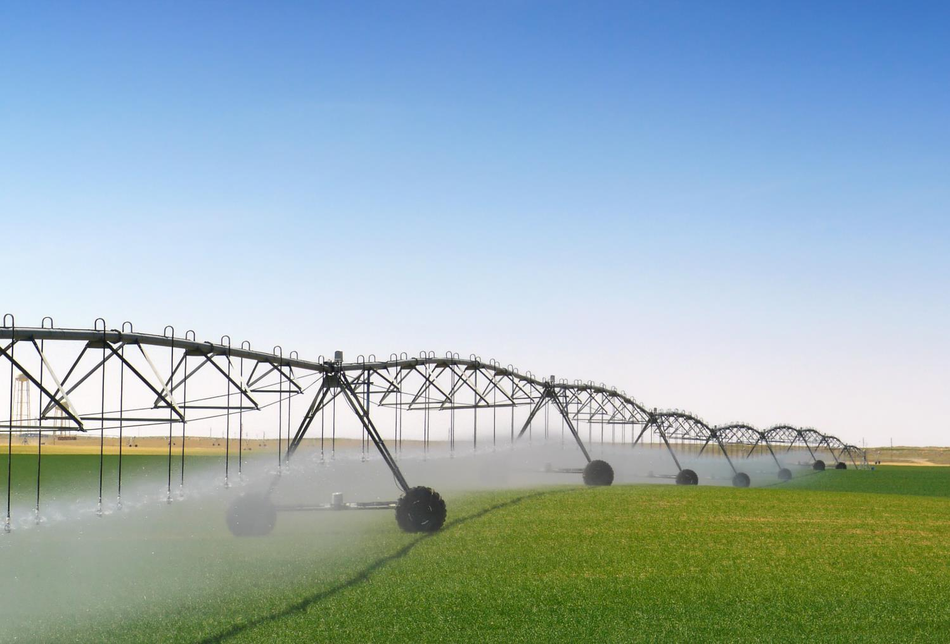
Sustainable or renewable?
What is the difference between sustainability and renewability?
Is cotton production sustainable, renewable or both?
Think of one resource that is sustainable but not renewable

Slide 26
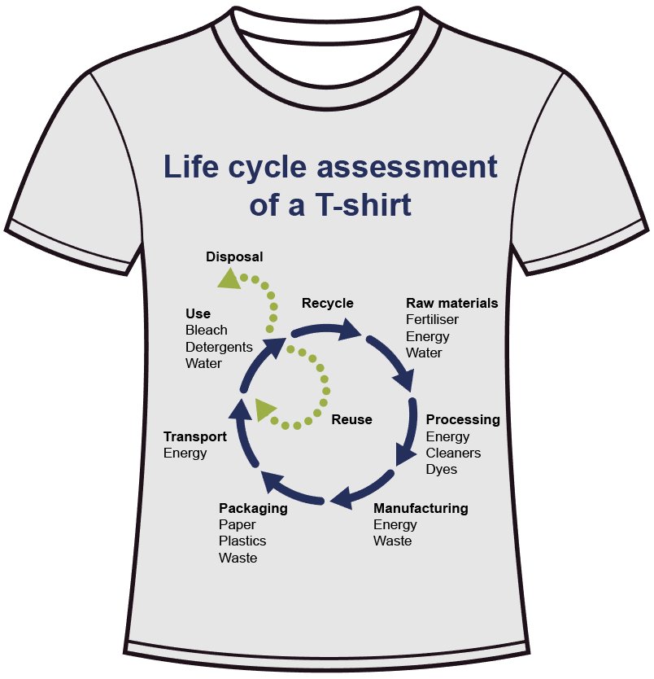
Worksheet 1
Complete Task 4

Slide 27
There is hope…
Many companies are starting to make changes in their practices
Many consumers are changing their habits as environmentalists work to raise awareness

