Slide 1
Digital Graphics

Slide 2
What are digital graphics?
Name 5 different examples below:
1.
2.
3.
4.
5.

Slide 3
What are the main purposes of Digital Graphics?
E_____________________
E_____________________
I______________________
I______________________
A_____________________
P______________________

Slide 4
Why is colour an important element in a digital graphic?
What other elements should you consider when designing digital graphics?

Slide 5
Identify the purpose of this digital graphic?
The purpose of this digital graphic is…
Explain your answer:

Slide 6
Identify the purpose of this digital graphic?
What is the main colour in this image?
Explain why this colour has been used in this type of graphic?

Slide 7
Identify the purpose of this digital graphic?
The purpose of this digital graphic is..
Explain your answer:

Slide 8
Identify the purpose of this digital graphic?
What is the main colour in this image?
Explain why this colour has been used in this type of graphic?

Slide 9
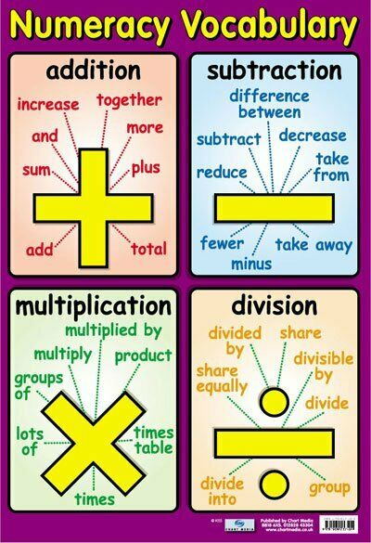
Identify the purpose of this digital graphic?
The purpose of this digital graphic is..
Explain your answer:

Slide 10
Identify the purpose of this digital graphic?
What is the main colour in this image?
Explain why this colour has been used in this type of graphic?
Identify the target audience of this graphic?
What age range ? and why?

Slide 11
Identify the purpose of this digital graphic?
The purpose of this digital graphic is..
Explain your answer:

Slide 12
Identify the purpose of this digital graphic?
What is the main colour in this image?
Explain why this colour has been used in this type of graphic?
Identify the target audience of this graphic?
What age range ? and why?

